Slide 1
Workshop on Arduino & Embedded Systems
Ashiqur Rasul and Zahid Hasan
Lecturer, Department of EEE,
Southeast University

Slide 2
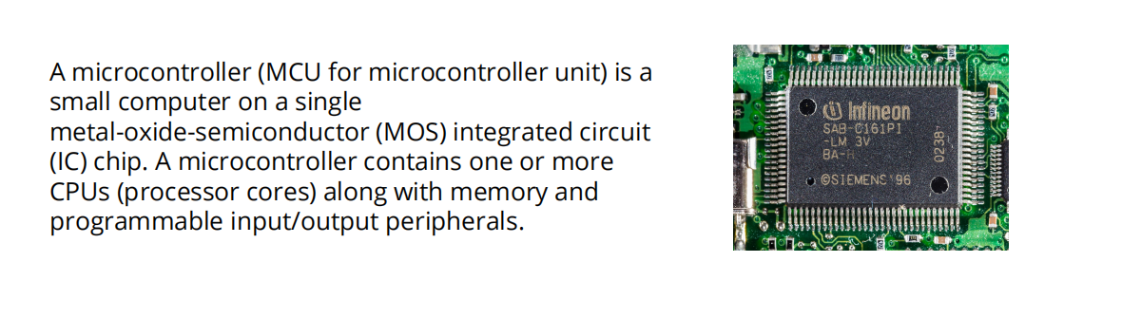
Introduction
A microcontroller (MCU) is a small computer on a single integrated circuit consisting of a relatively simple central processing unit (CPU) combined with peripheral devices such as memories, I/O
devices, and timers.
By some accounts, more than half of all CPUs sold worldwide are microcontrollers

Slide 3
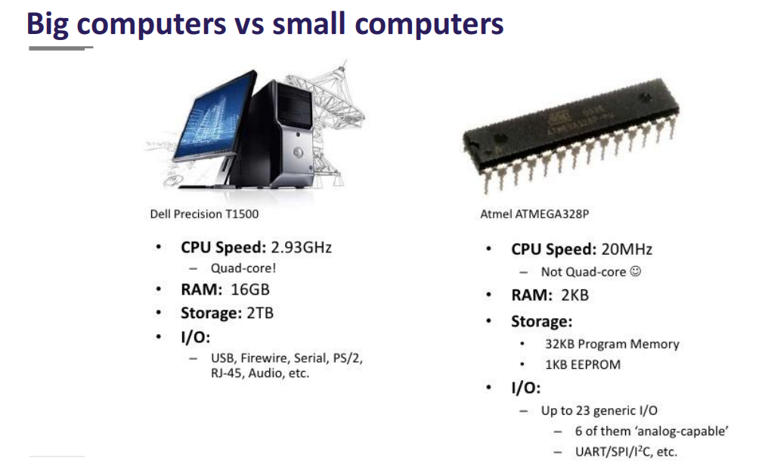
Introduction

Slide 4
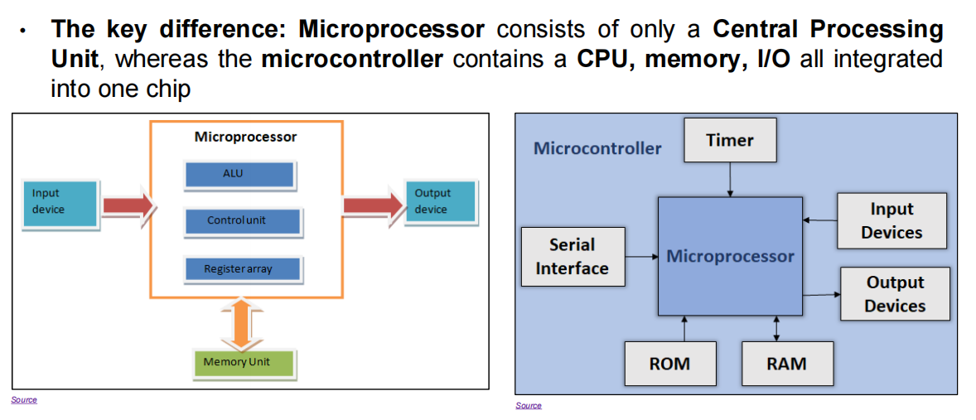
Introduction

Slide 5
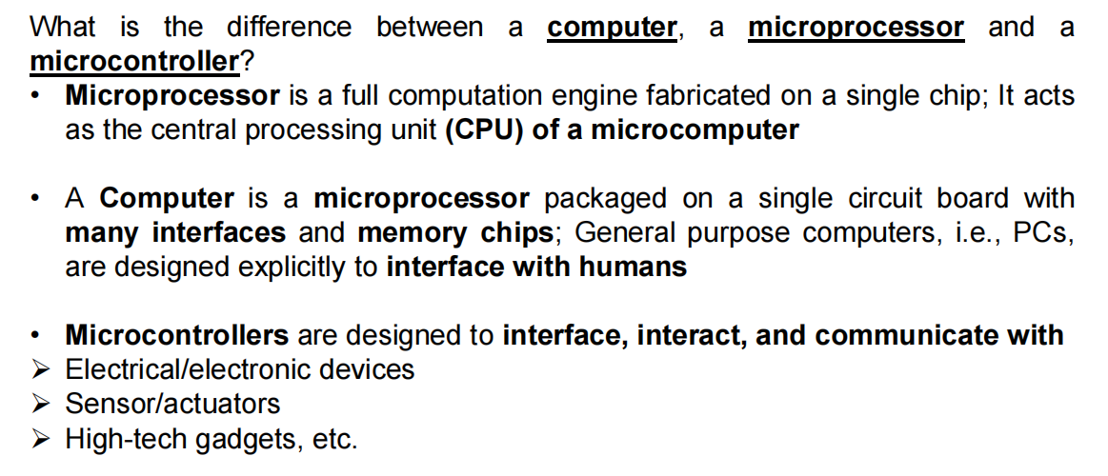
Introduction

Slide 6
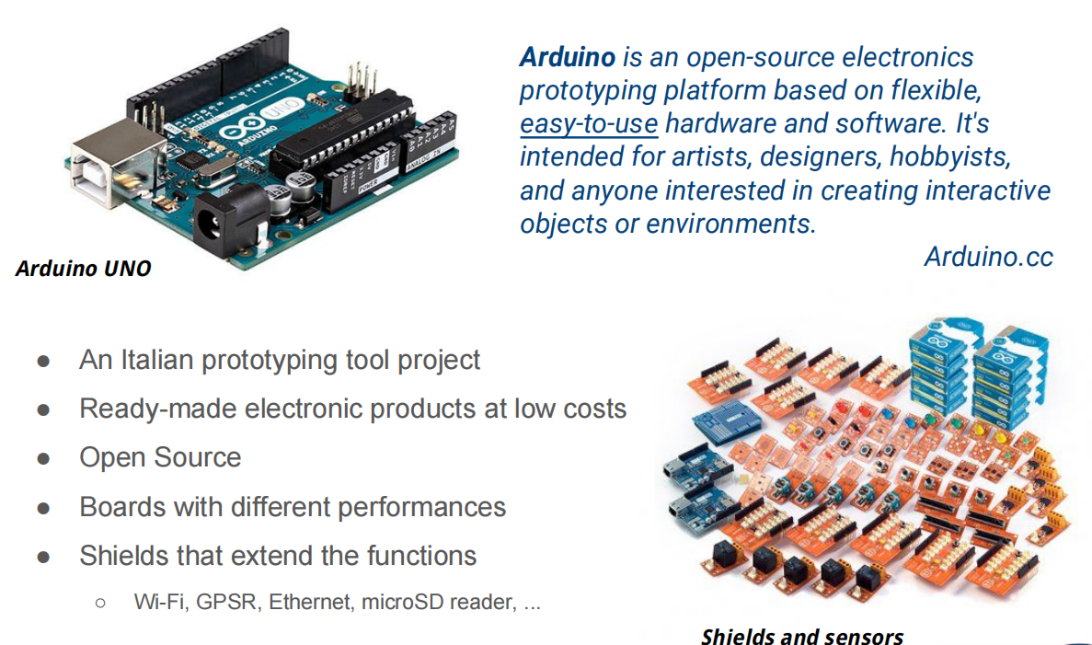
Introduction

Slide 7
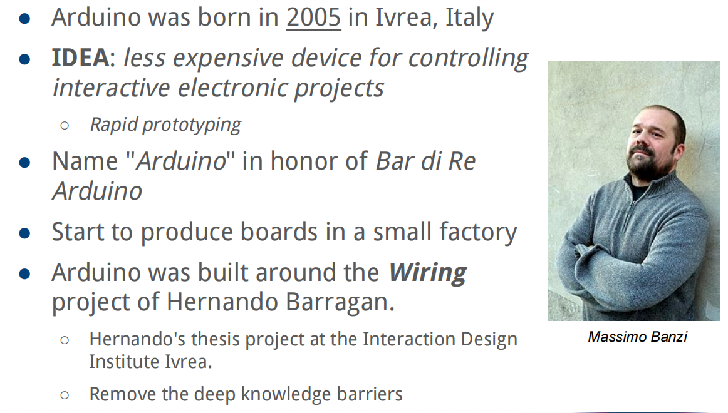
Introduction

Slide 8
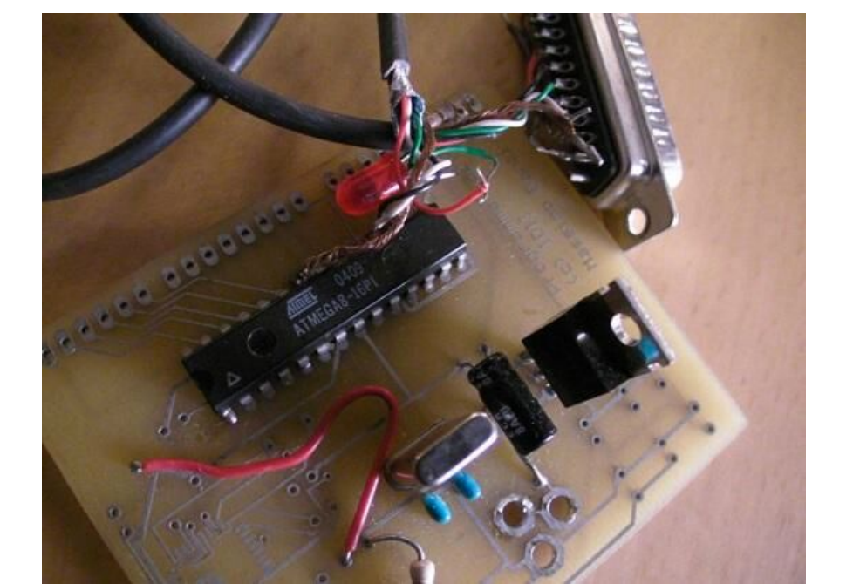
Introduction

Slide 9
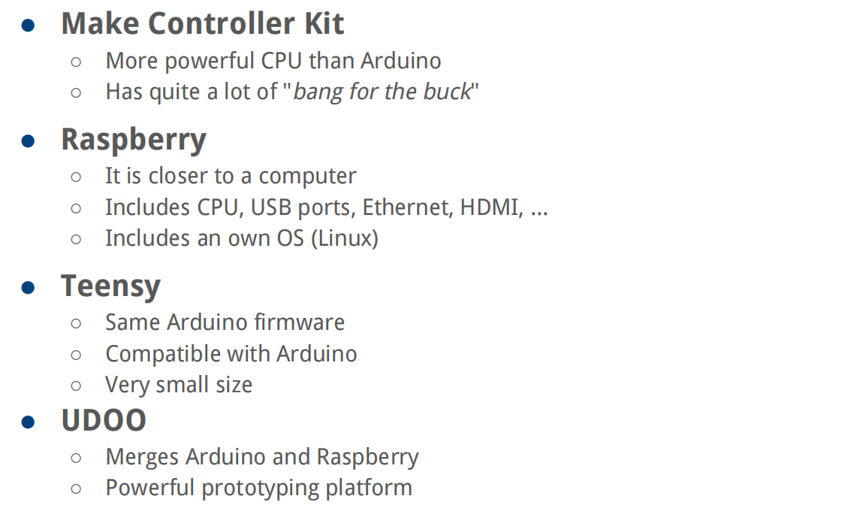
Introduction

Slide 10
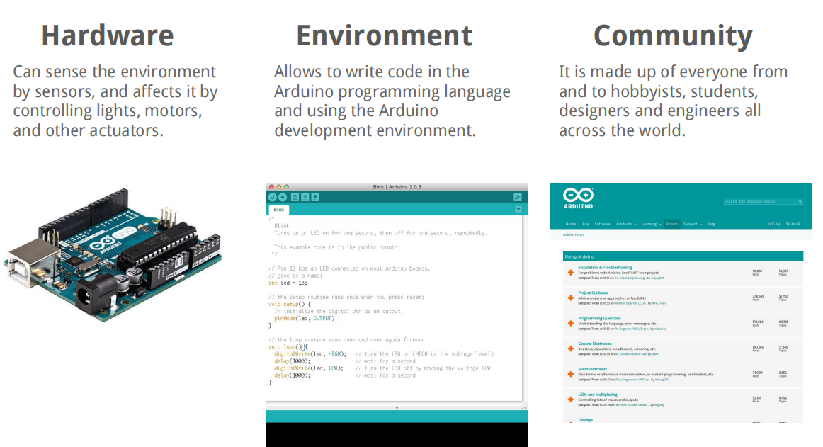
Introduction

Slide 11
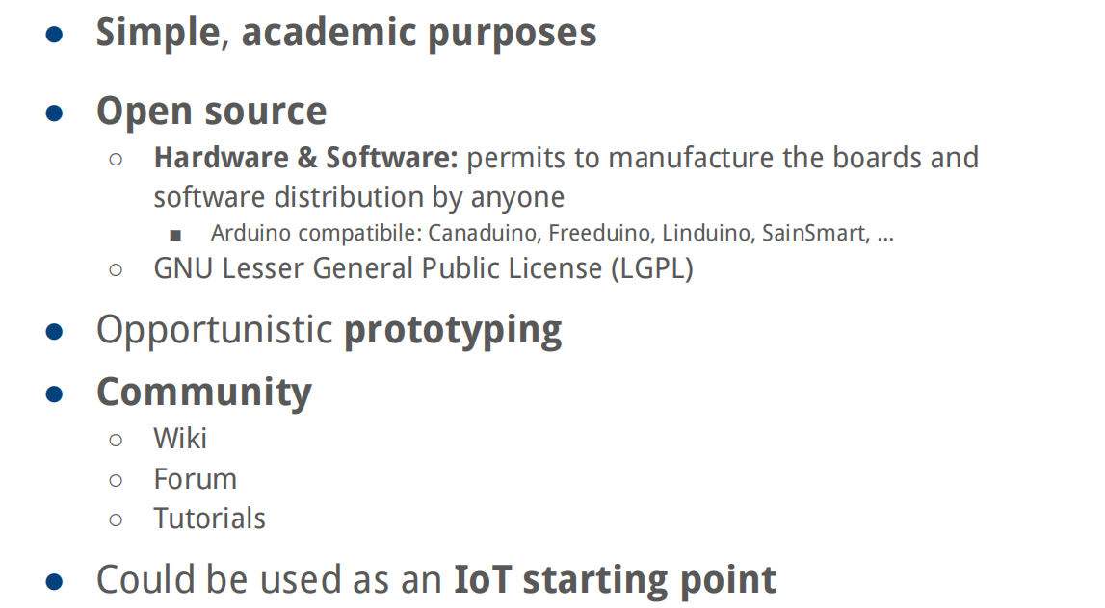
Introduction

Slide 12
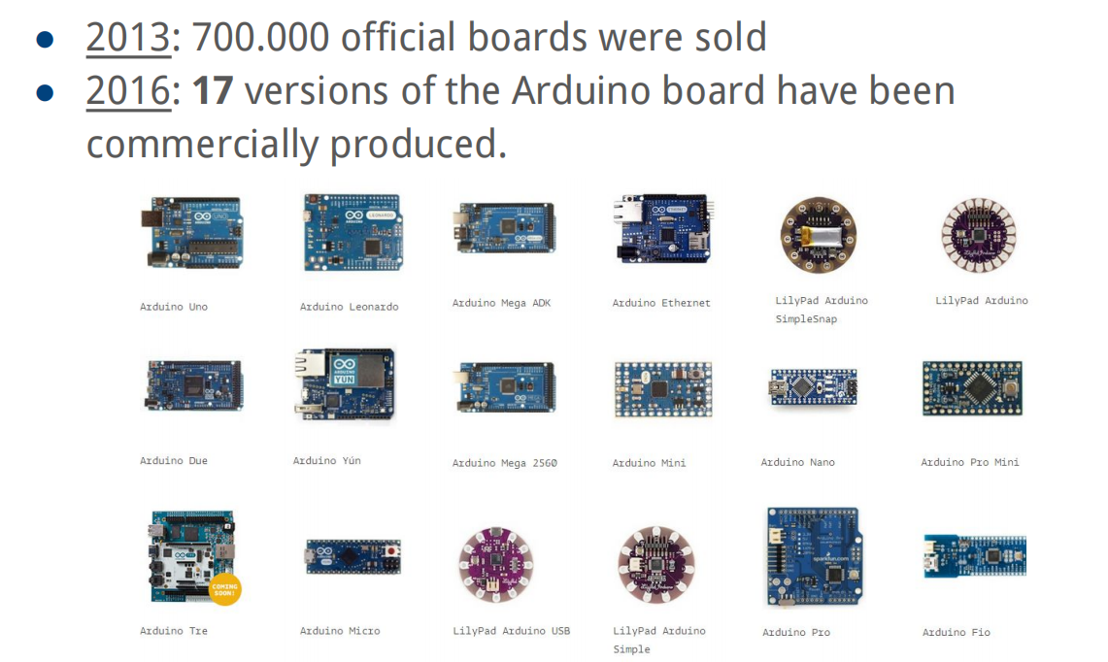
Introduction

Slide 13
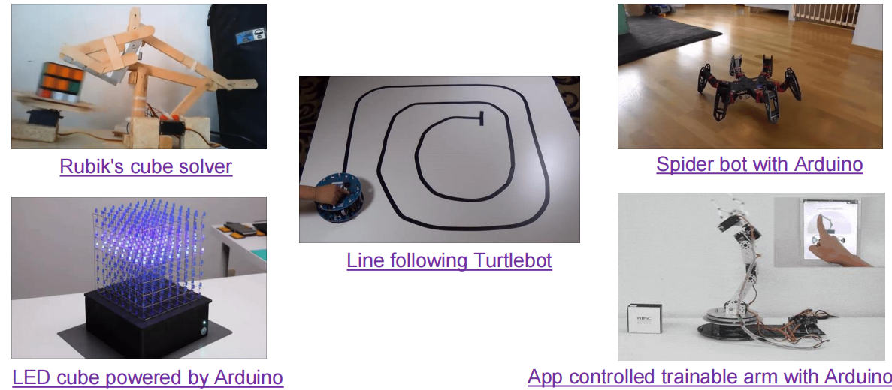
Introduction

Slide 14
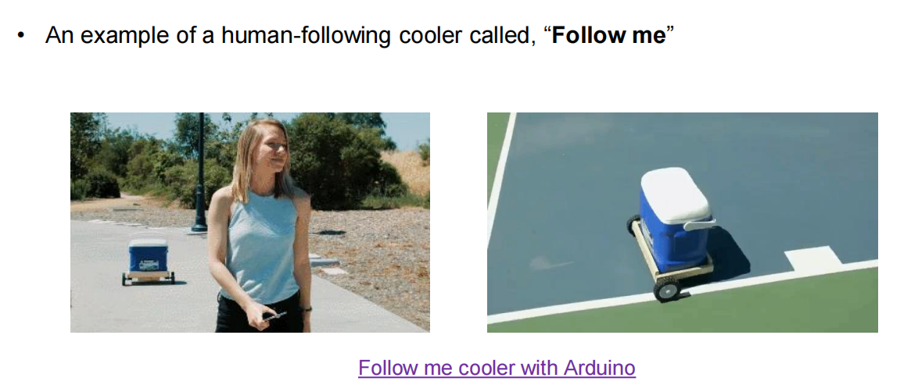
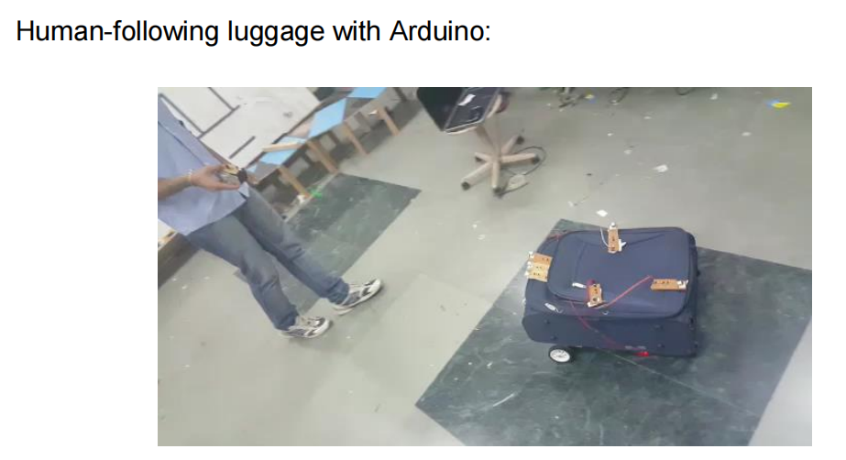
Introduction

Slide 15
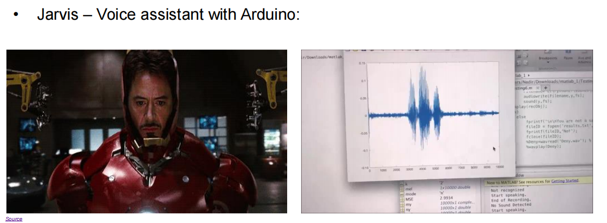
Introduction

Slide 16

Introduction

Slide 17
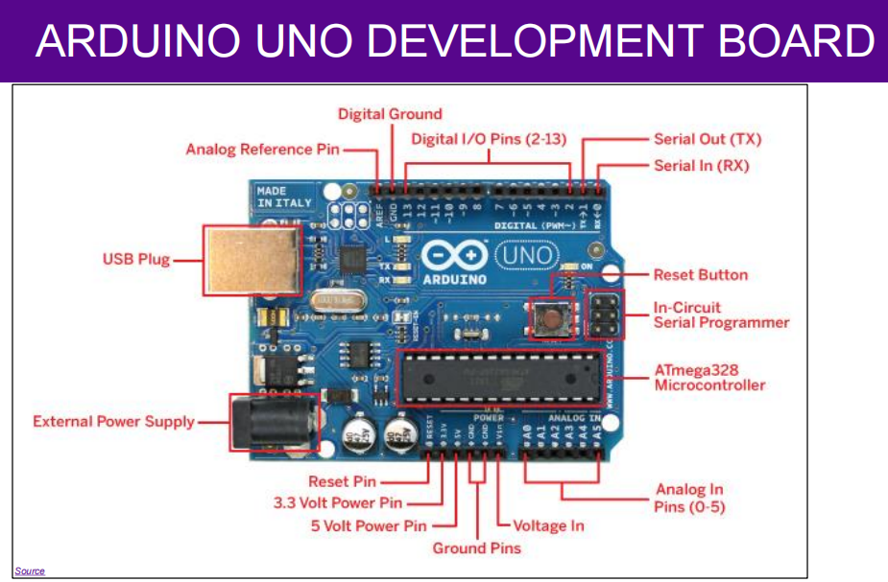
Introduction

Slide 18
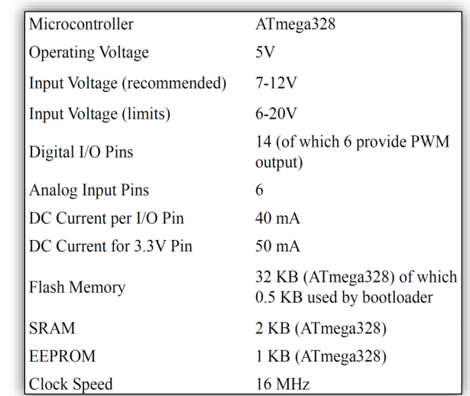
Introduction

Slide 19
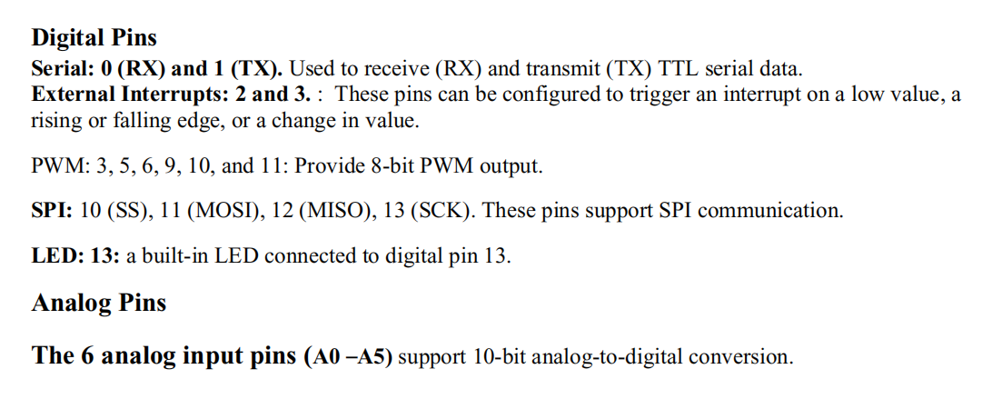
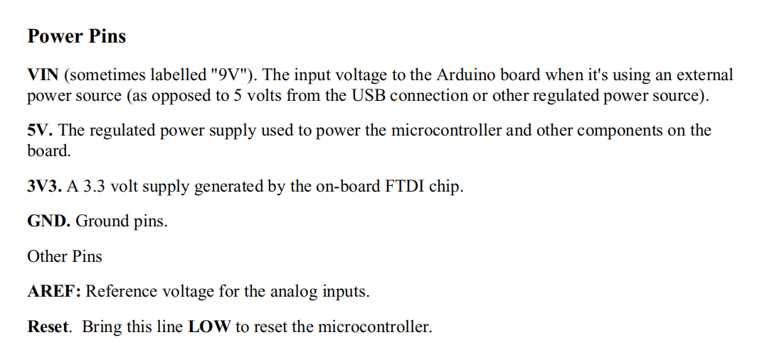
Introduction

Slide 20
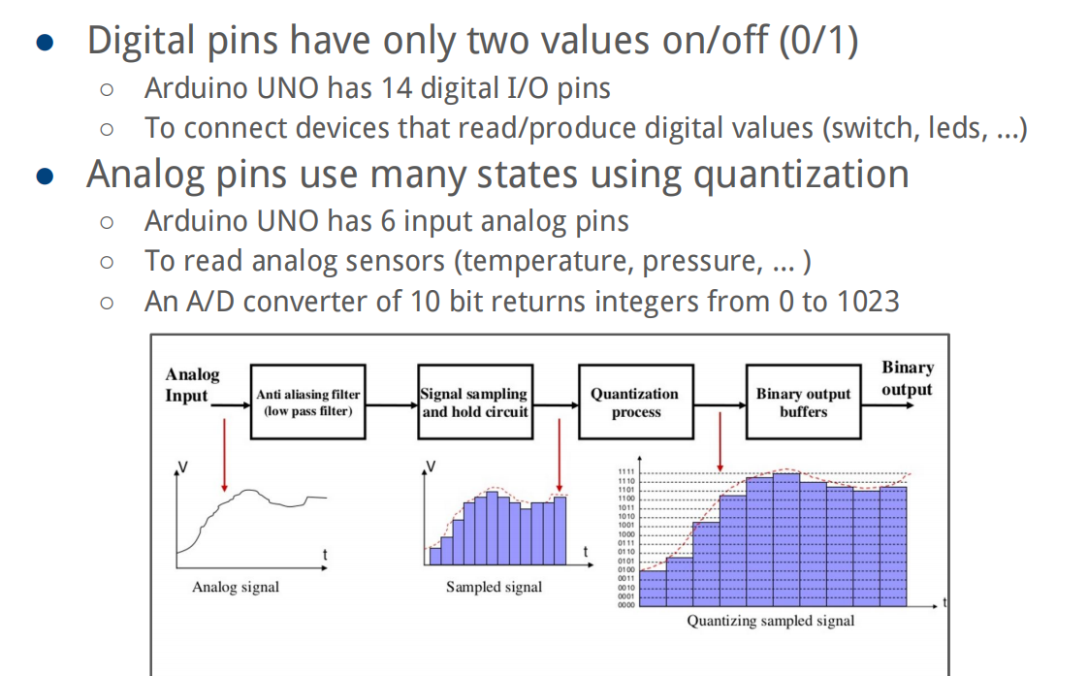
Introduction

Slide 21
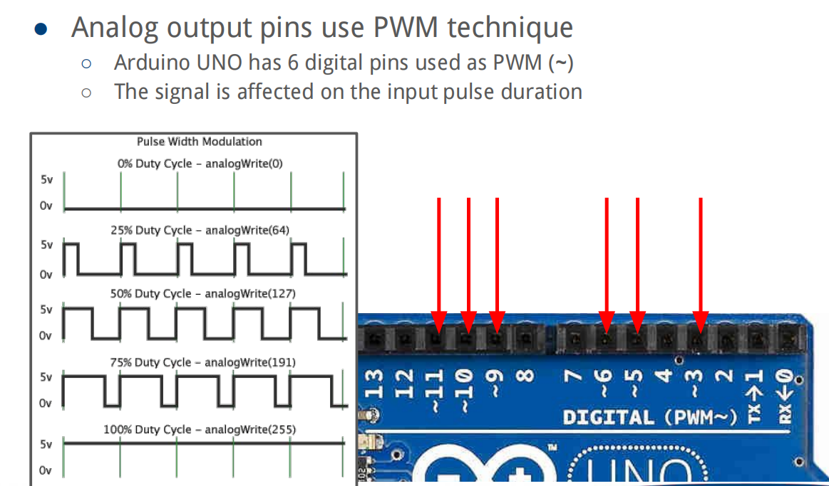
Introduction

Slide 22
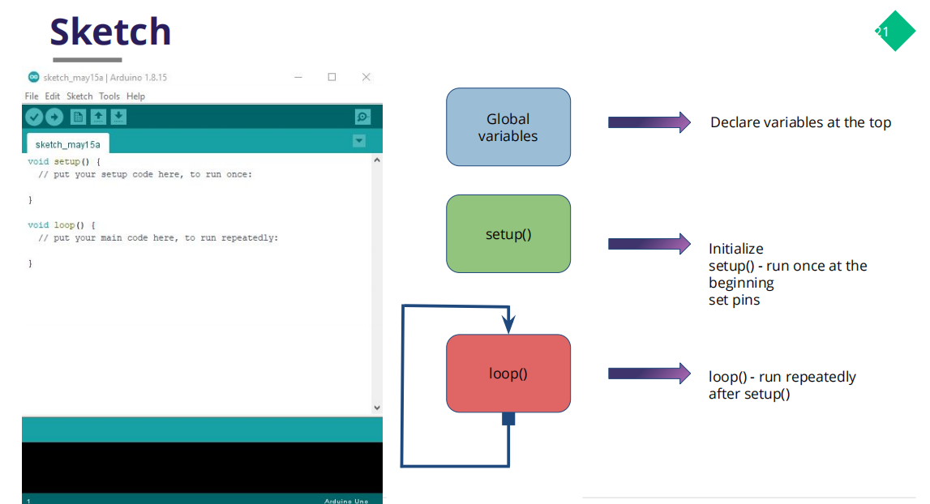
Introduction

Slide 23
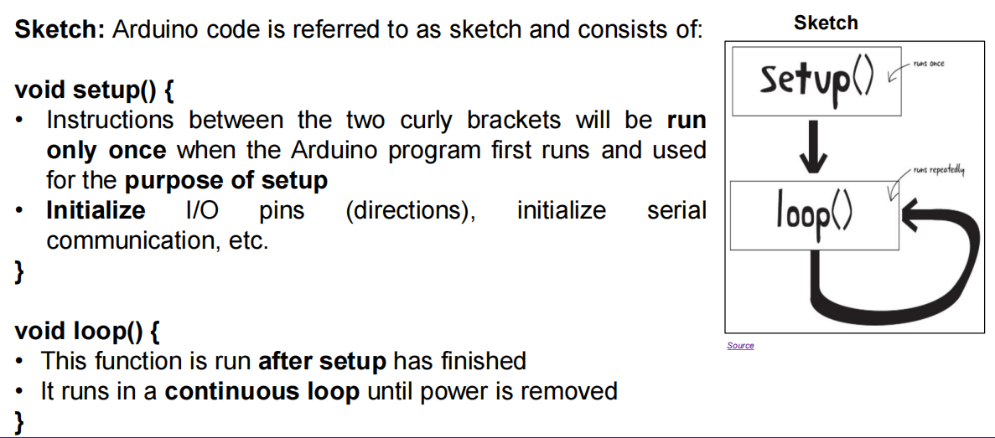
Introduction

Slide 24
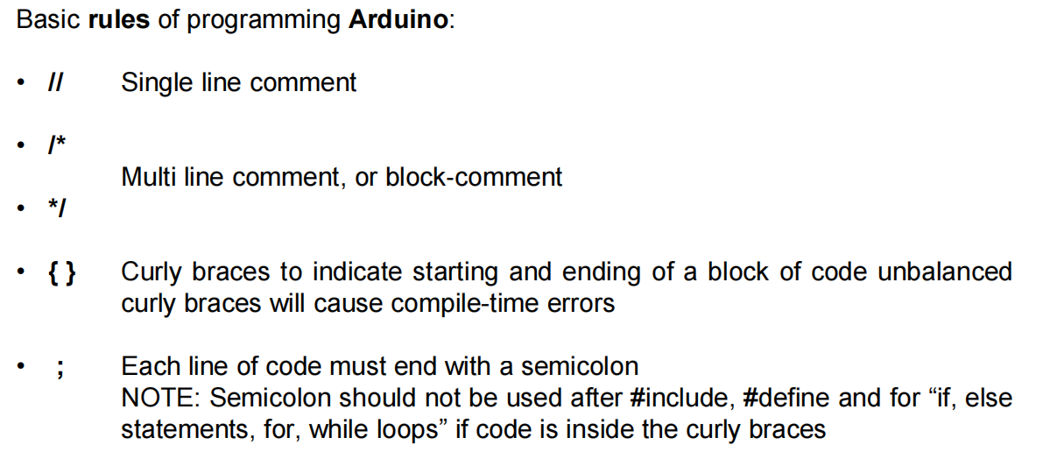
Introduction

Slide 25
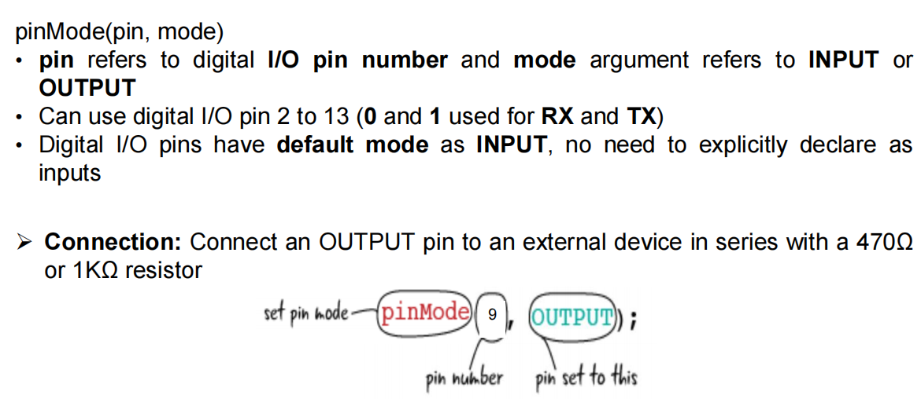
Introduction

Slide 26
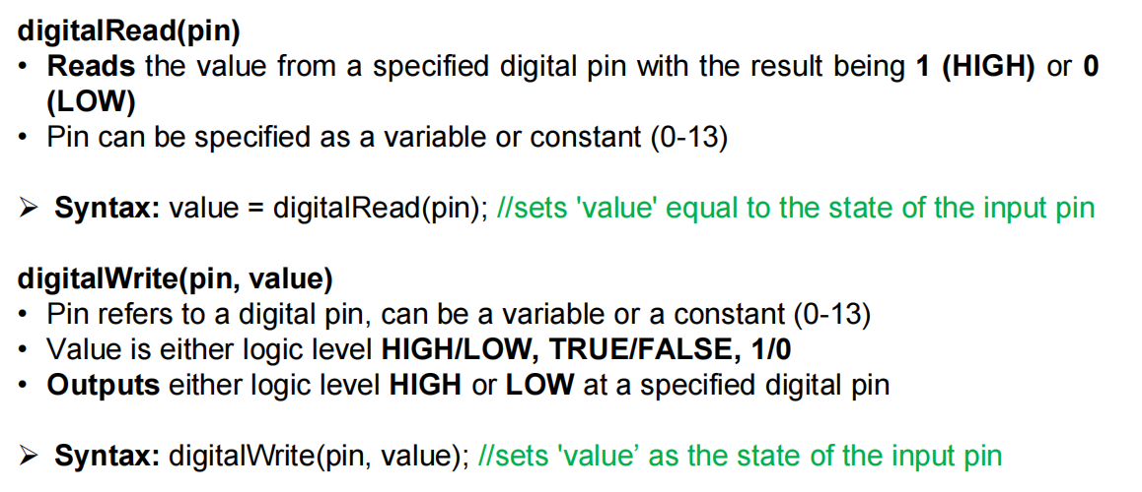
Introduction

Slide 27
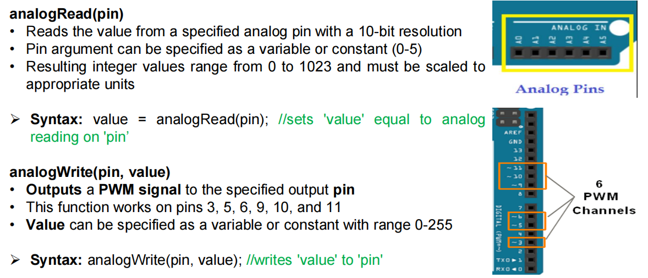
Introduction

Slide 28
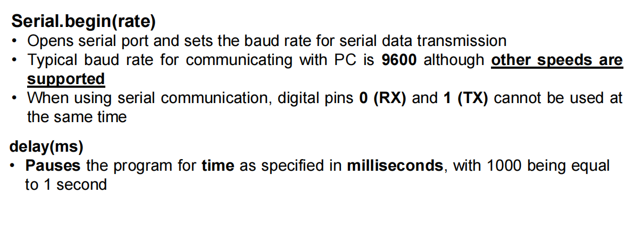
Introduction

Slide 29
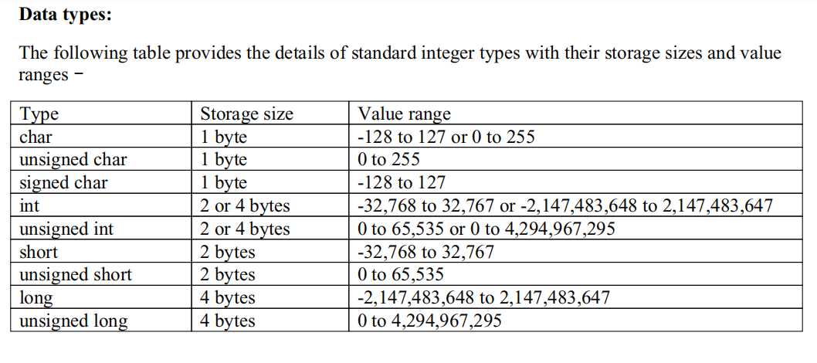
Introduction

Slide 30
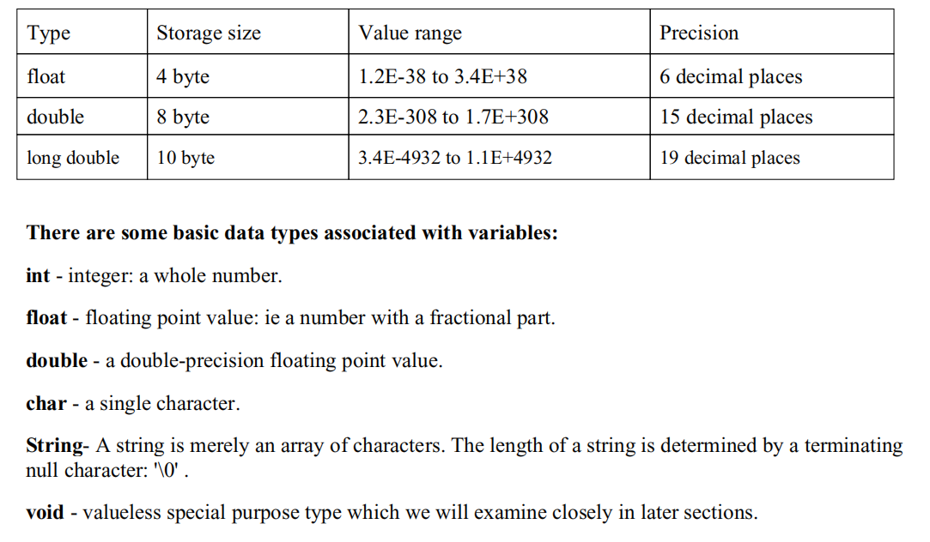
Introduction

Slide 31
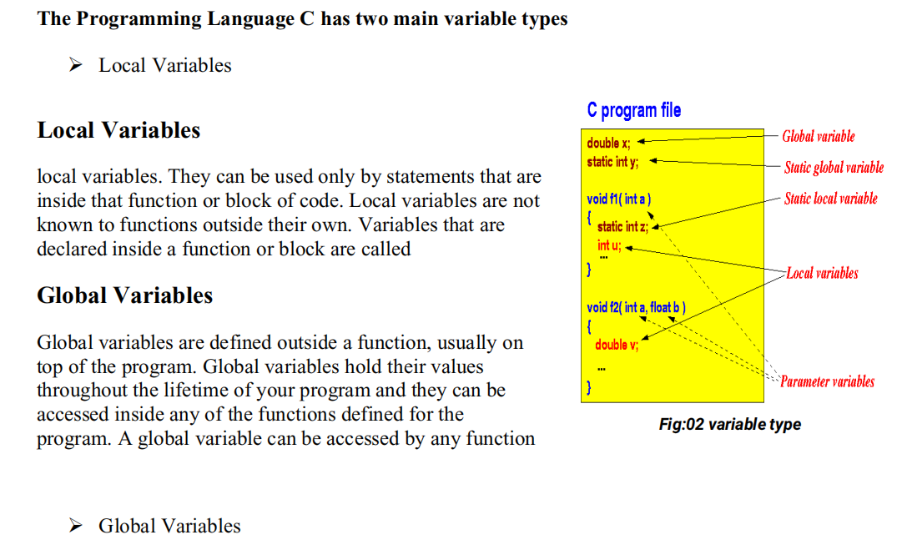
Introduction

Slide 32
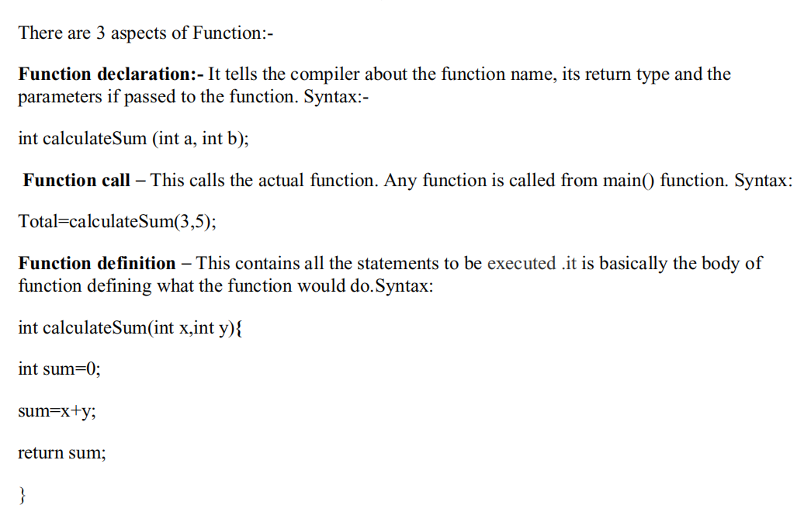
Introduction

Slide 33
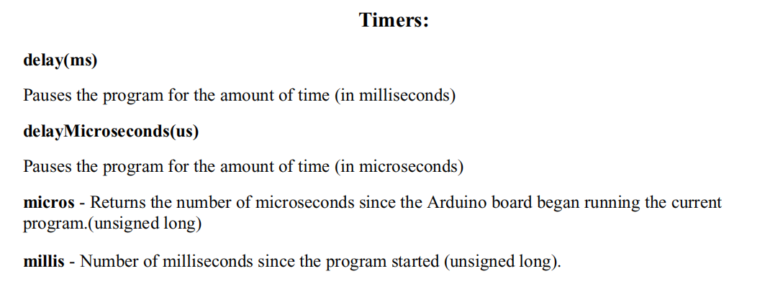
Introduction

Slide 34
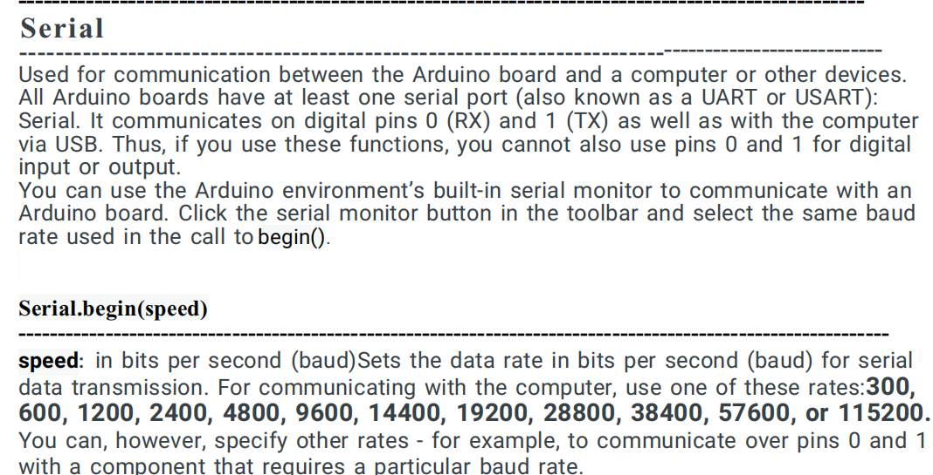
Introduction

Slide 35
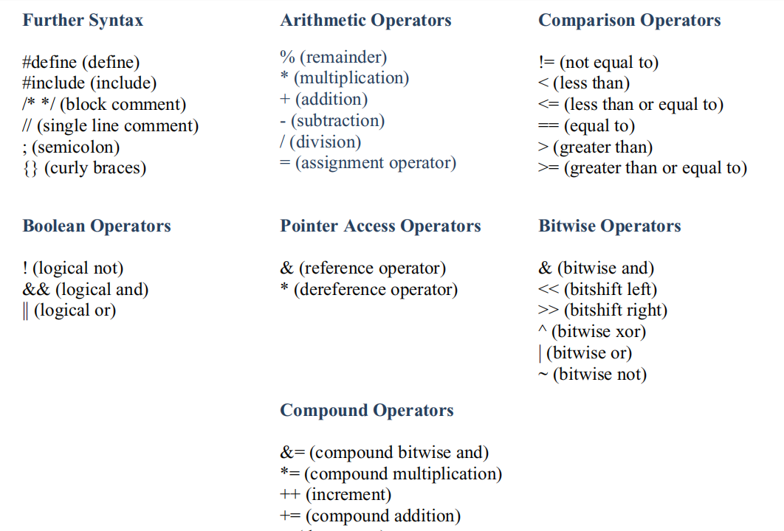
Introduction

Slide 36
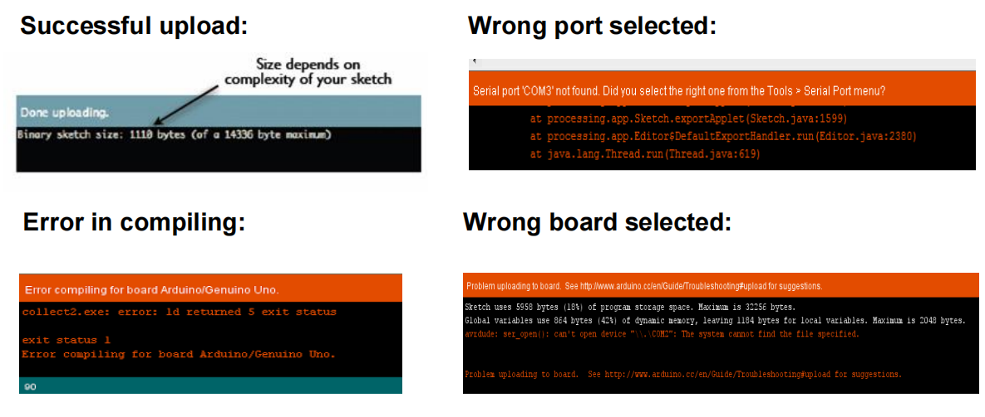
Introduction

Slide 37
THANK YOU

